Slide 1
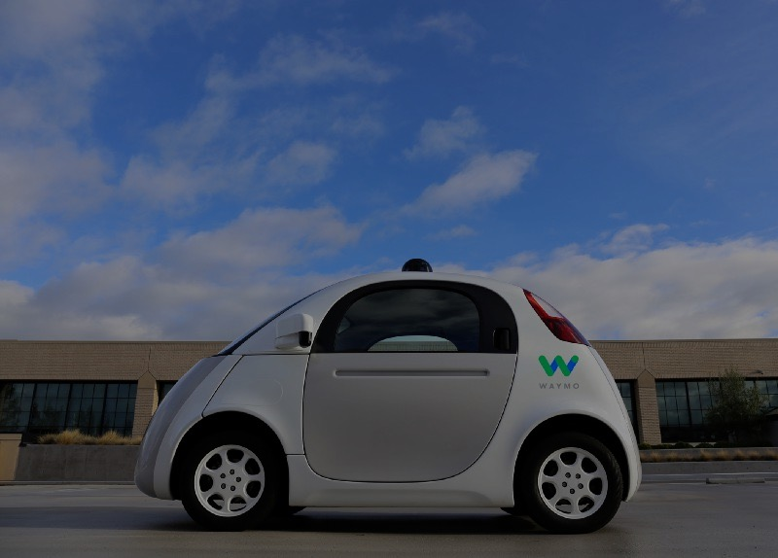
Open-Sourcing Self-Driving Cars
Alexey Simonov

Slide 2
Open Sourcing Self-Driving Cars
Outline
I. Brief History
II. Open Source, DIY, Udacity
III. DEMO: Behaviour Cloning
Alexey Simonov

Slide 3
Open Sourcing Self-Driving Cars
I. Brief History of Self-driving Cars
1920s, 50s, 90s …
2005 DARPA Grand Challenge – 132 Miles of Fully Autonomous Desert Driving
Winner: robot Stanley by Stanford Team
http://www.cs.stanford.edu/people/dstavens/thesis/David_Stavens_PhD_Dissertation.pdf
2007 DARPA Urban Challenge – 60 Miles of ‘Urban’ Driving
Winner: CMU/GM team.
Second Place: robot Junior by Stanford Team
http://robots.stanford.edu/papers/junior08.pdf
2009 Google X
Mostly Stanford team develops the first prototypes of Google autonomous cars
~2014 Everyone: big car manufacturers, ridesharing companies, OEM suppliers etc start working on mass-market SDC technology
2017: most companies promise Level 5 autonomy by 2020
Alexey Simonov

Slide 4
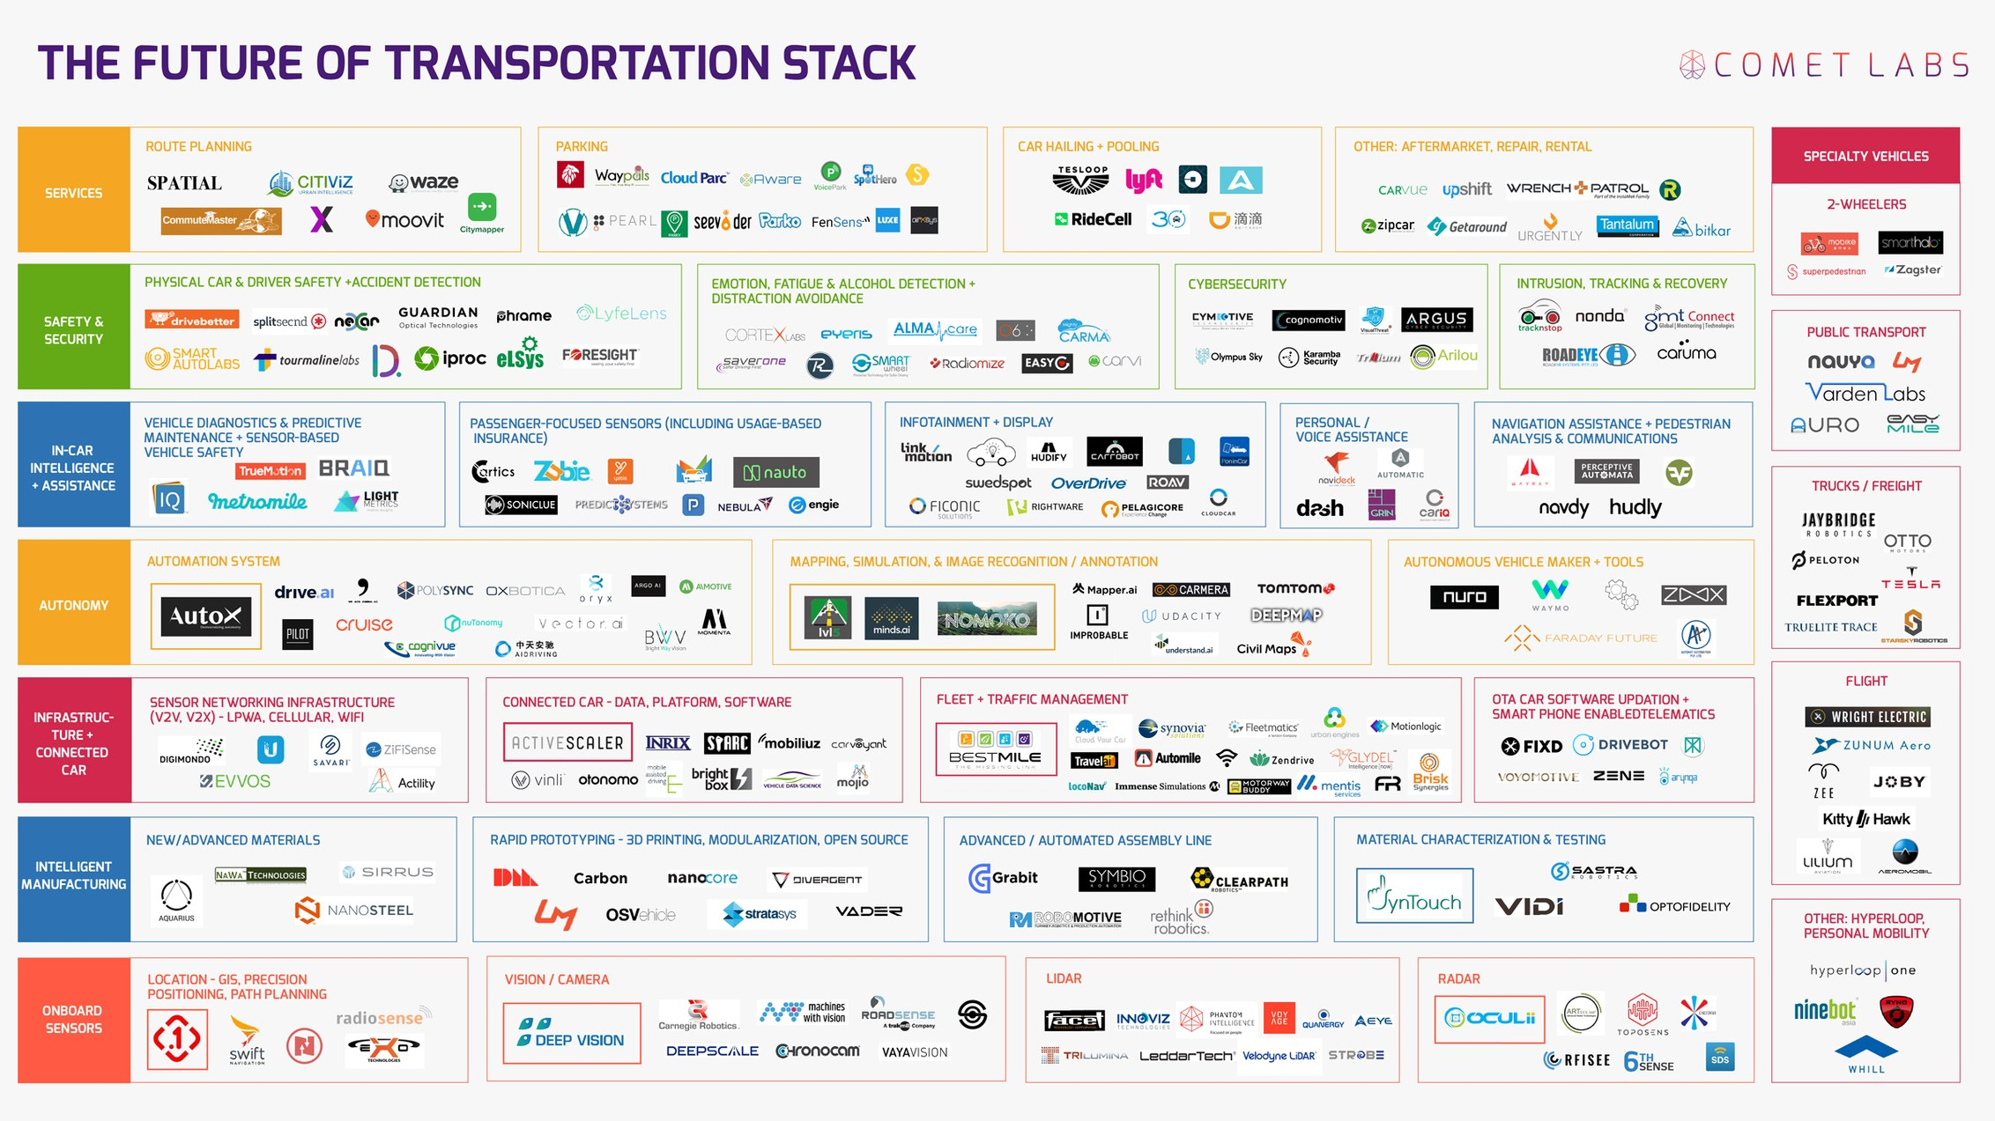
Open Sourcing Self-Driving Cars
I. Brief History of SDC: 2017
Comet Labs: 263 Companies Racing Towards Autonomous Cars
Alexey Simonov

Slide 5
Open Sourcing Self-Driving Cars
I. Brief History of SDC: Main Catalysts
Why now?
Main catalysts:
Advances in car technology
Electric powertrain
Drive-by-wire controls
Advanced driver assistance systems
Cheaper and better sensors: cameras, RADARs, LIDARs
Connectivity/Cloud/Big Data
detailed 3D maps
traffic, driving patterns data
other crowd-sourced data
AI / Machine Learning / Computer Vision
Better compute capabilities at ‘The Edge’ – GPUs, ASICs etc
State of the art results in image recognition/classification
State of the art results in reinforcement learning
Alexey Simonov

Slide 6
Open Sourcing Self-Driving Cars
II. Open Source: It is all about SOFTWARE
Logical Next Step: Open-Source [self-driving cars]
We know this in PyData community ☺
Seriously?
Well, it turns out it is [almost] all about software.
Autonomous car is a ROBOT, which does the following, in a loop:
Perceive the world through sensors (HARDWARE)
Make sense of the world and plan an action (SOFTWARE – 90%)
Execute the action (HARDWARE)
April 2017: https://www.technologyreview.com/s/604220/baidu-will-release-a-free-operating-system-for-self-driving-cars/
I told you! We’d better be quick, after all we use Python and they are probably on C++!
Alexey Simonov

Slide 7
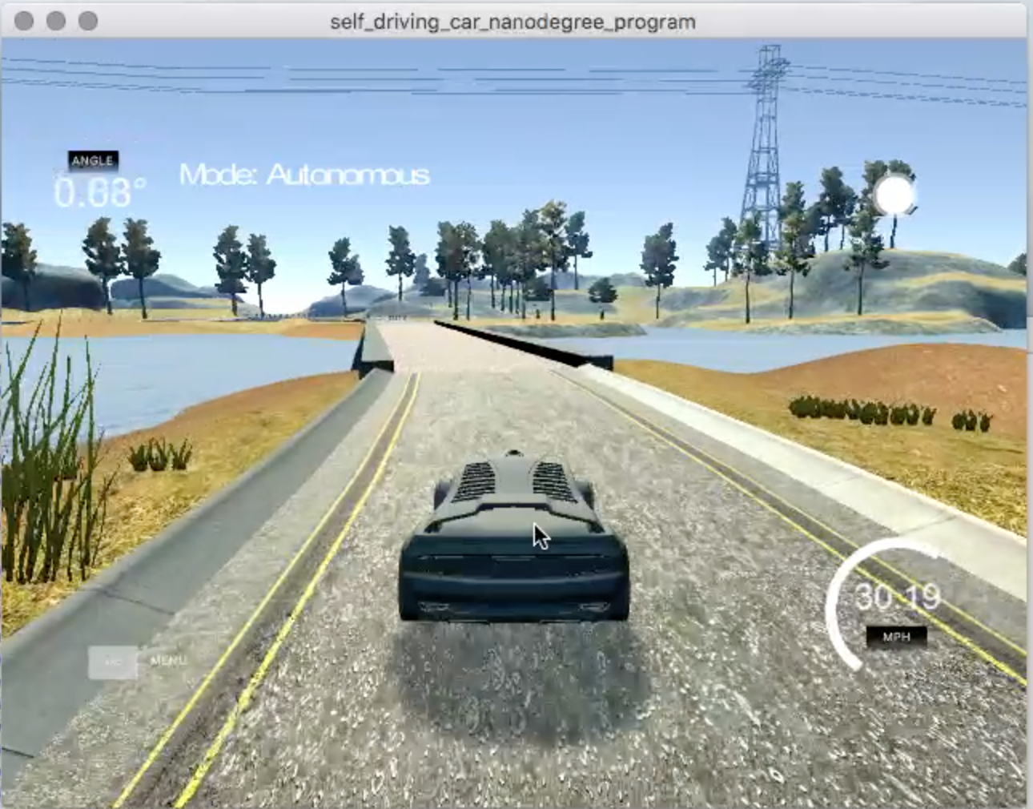
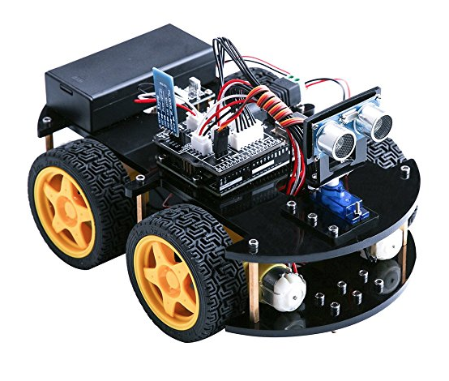
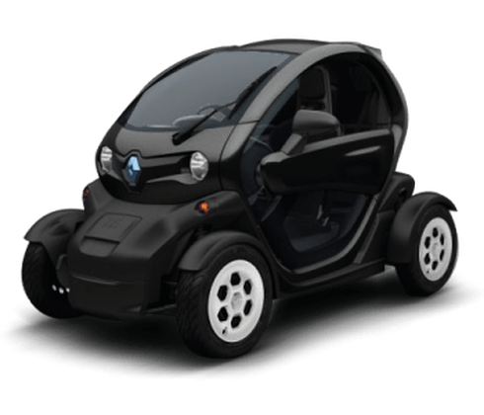
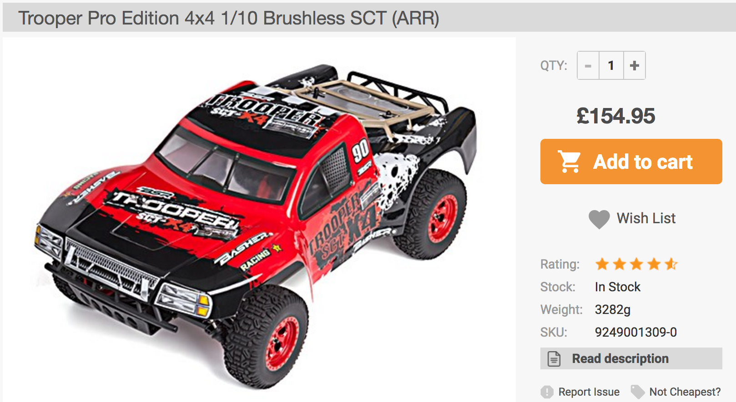
Open Sourcing Self-Driving Cars
II. Open Source: Hacking, DIY
So, how do I hack a self-driving car?
Choose hardware platform:
Simulator / ROS
toy
medium-size (1/10)
full-size (streetdrone.co.uk)
Alexey Simonov

Slide 8
Open Sourcing Self-Driving Cars
II. Open Source: More Hardware Ideas
More hardware ideas:
Drive-by-wire Kits For Full Size Vehicles (available to public)
http://oscc.io/ - 1000$ Kia Soul 2014+, https://github.com/PolySync/OSCC
http://www.autonomoustuff.com/wp-content/uploads/2016/08/ADAS-Development-Vehicle-Kit.pdf - Lincoln MKZ or Ford Fusion
DIY Toy Car Kits:
https://mit-racecar.github.io/hardware/ - based on https://traxxas.com plus NVIDIA Jetson plus cameras, laser range sensors, IMU and ECU for wheel odometry
https://diyrobocars.com/raspberrypiarduino-car/ -- and many other designs
https://docs.google.com/spreadsheets/d/1iaOru6va1LXjhXfBtYTWhAH_3DQlvVIdpRZ0NJh-7q8/edit?usp=sharing -- possible configuration
Alexey Simonov

Slide 9
Open Sourcing Self-Driving Cars
II. Open Source: Data and Programming
Open-Source Software
Tensorflow and other Deep Learning frameworks
OpenCV for computer vision
ROS – Robotics Operating System
Trained models for object detection, image segmentation, visual SLAM
…
Open Data Sets
http://synthia-dataset.net/
http://www.cvlibs.net/datasets/kitti/
http://ori.ox.ac.uk/the-oxford-robotcar-dataset/
…
Alexey Simonov

Slide 10
Open Sourcing Self-Driving Cars
II. DIY and Open Source (2)
Meetups:
https://www.meetup.com/DIYRobocars -- California
Open Source Projects:
https://github.com/OSSDC -- Open Source Self Driving Car Initiative
http://comma.ai/
Alexey Simonov

Slide 11
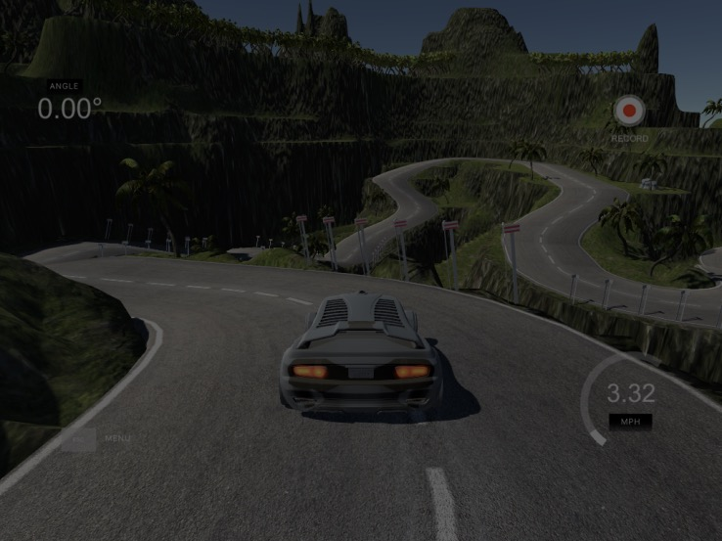
Thank you!
Questions?
Alexey Simonov
https://www.linkedin.com/in/alexeysimonov/

